Slide 1


PawConnect: Revolutionizing Pet Adoption
Connecting people with pets in the Kumaon and Hill regions for a better tomorrow. PawConnect bridges the gap between stray animals and loving homes, creating a compassionate community committed to animal welfare.
Our initiative aims to transform the pet adoption landscape in the Himalayas by combining technology and local efforts.

Slide 2
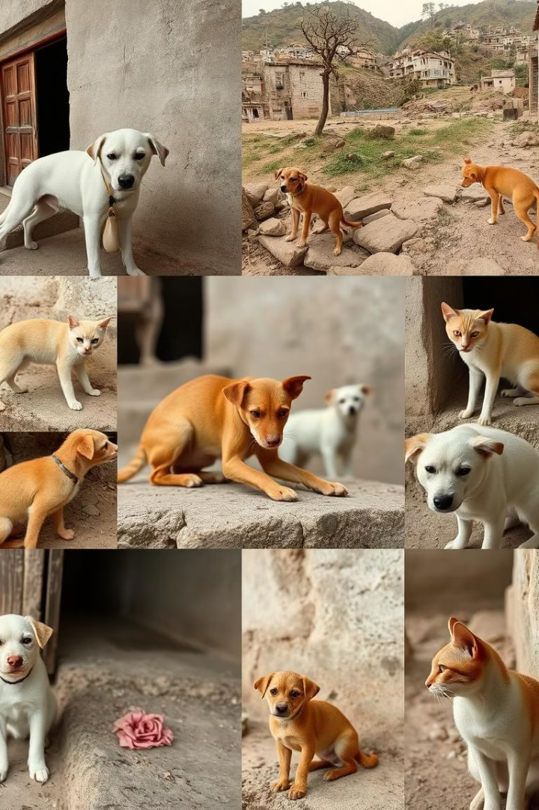



The Problem: A Dire Situation
Low Adoption Awareness
Stray Animal Crisis
Stray dogs and cats suffer from lack of food, shelter, and medical care, leading to poor health and increased risks to the community.
Many hill region residents lack awareness about pet adoption options and processes, resulting in stray animals being ignored.
Health and Environmental Risks
Overpopulation of strays contributes to the spread of diseases, bites, and increasing public health concerns in remote areas.

Slide 3

Introducing PawConnect: Our Solution
Connecting Adopters and Pets
Technology-Enabled Adoption
Community-Driven Approach
PawConnect links people interested in adopting with rescued animals needing homes, focusing on hill regions like Kumaon, Himachal, and J&K.
Our digital platform offers transparent, fast adoption processes with real-time updates, making it accessible and trustworthy.
We collaborate with local NGOs and volunteers to ensure pets receive proper care, and adopters have continued support.

Slide 4
Our Mission & Vision
Mission
Vision
Core Values
To find loving, responsible homes for every stray animal, improving welfare in hill regions.
Cleaner, safer urban and rural areas in Uttarakhand and beyond
Compassion
Responsibility
Responsible pet care becoming part of local culture
Community
Harmony between wildlife, locals, and tourists preserved
Structured adoption reduces stray populations and community discomfort

Slide 5
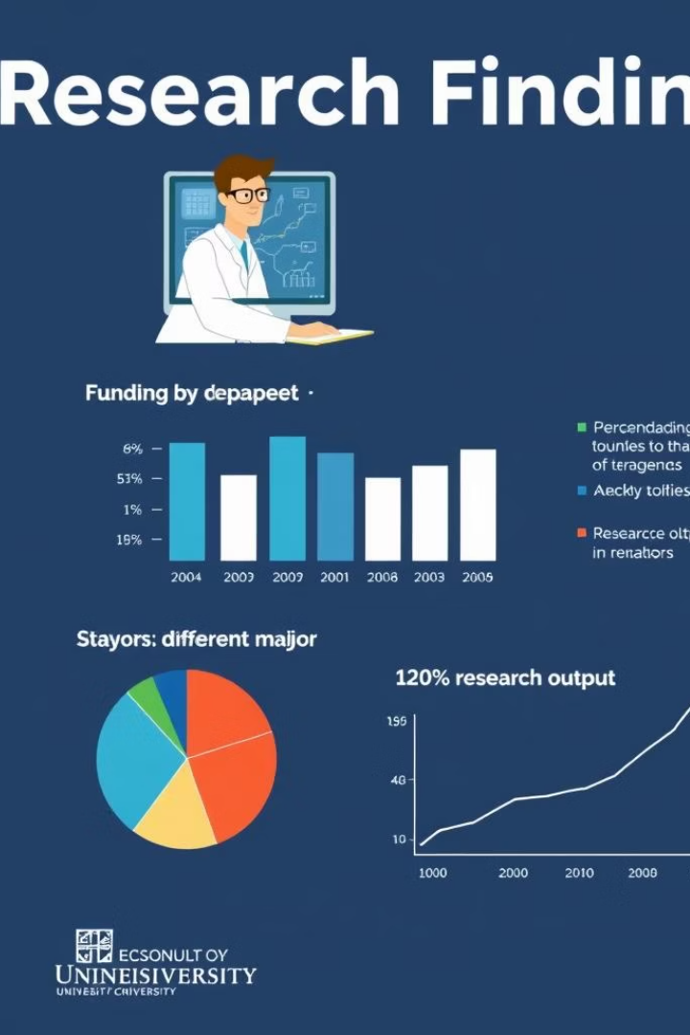





The Hidden Potential: Backed by Research
Escalating Stray Crisis
India has over 62 million stray dogs and 9.1
million street cats, with Uttarakhand’s rural communities severely affected.
million street cats, with Uttarakhand’s rural communities severely affected.
Challenges in Hill Terrain
Remote areas lack veterinary access and sterilization programs, accelerating stray growth and risk.
Public Health Risks
Unchecked strays contribute to rising dog bites and rabies deaths, a global concern concentrated in India.
Tourism & Community Impact
Clean, safe hill towns with managed stray populations enhance eco-tourism and community wellbeing.

Slide 6

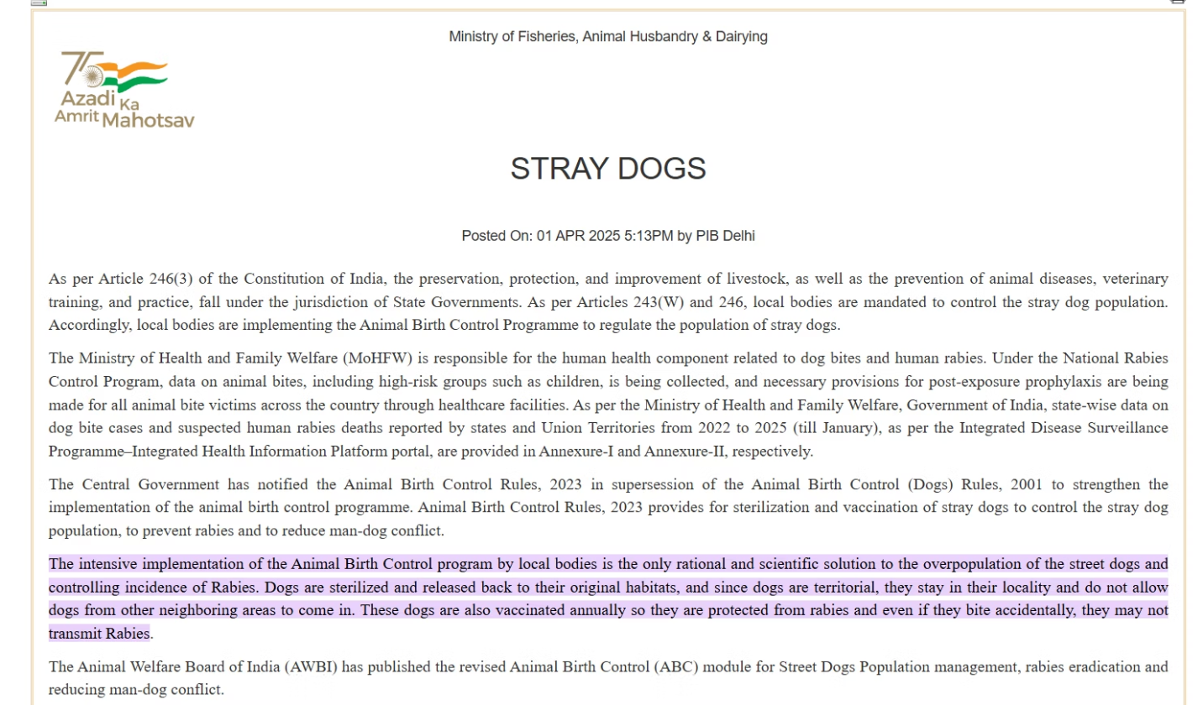
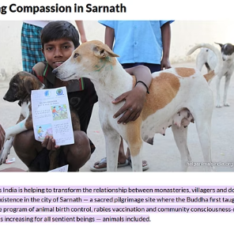
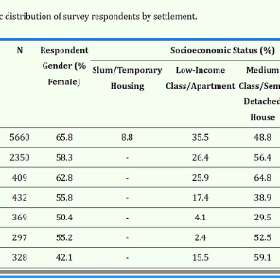

Slide 7

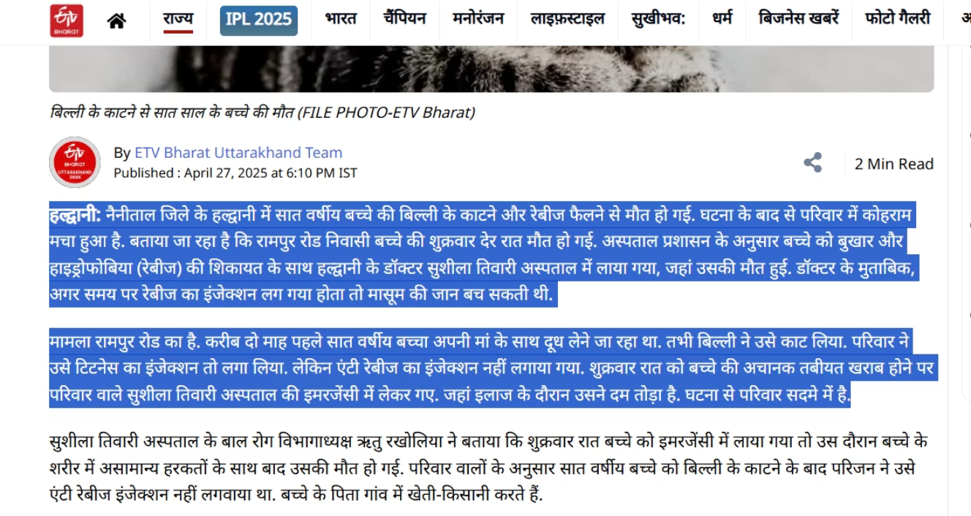
A 7-year-old boy died of rabies in Haldwani after a cat bite. The family gave a tetanus shot but skipped the anti-rabies injection. He died during emergency treatment. Doctors stress that anti-rabies shots must be given within 24 hours of any animal bite.

Slide 8

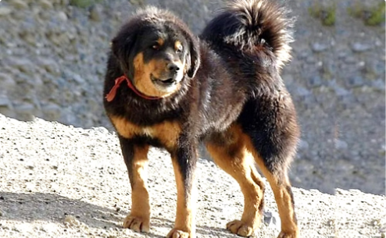

Why the Hills? Cultural & Ecological Justification
Hill regions like Uttarakhand, Kashmir, and Himachal are pet-friendly by culture. Most households in these areas own at least one mountain dog or pet for companionship and safety. These pets are naturally adapted to the harsh climate and terrain of the hills.
Promoting the adoption of these native hill breeds ensures better identification and care of these unique animals. It helps preserve local species like the Bhotia Dog, Bakharwal, and others, supporting the local identity and encouraging inclusive, eco-conscious living.
Native Hill Breeds
Families with Hill Pets

Slide 9
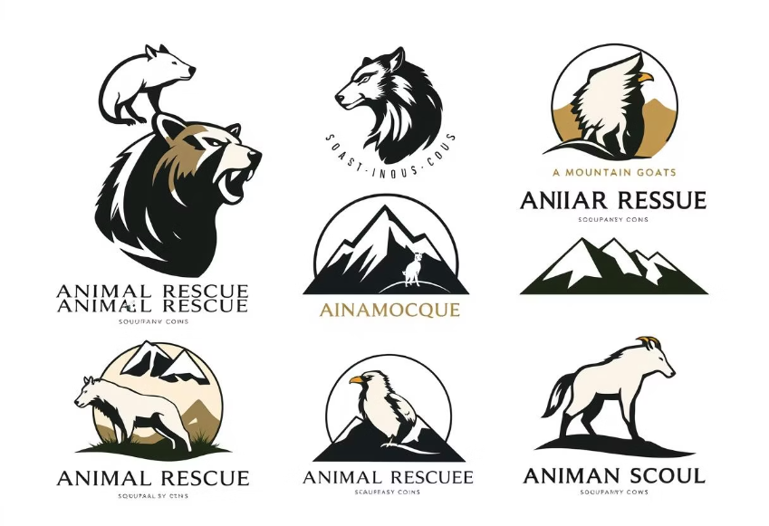

Partner NGOs & Our Support Ecosystem
SAHARA - Rescue & adoption in Haldwani
Tech onboarding and training for NGOs
Howl: The Voice of Strays - Welfare and sterilization drives
Centralized dashboards to manage adoptions and volunteers
Himalayan Rescuer Society - Shelter for Himalayan dogs
Marketing kits and social media templates
SUKOON - Rescue and sterilization camps
Geo-mapping for rescue coordination
Data analytics for impact tracking
Volunteer management tools

Slide 10





How PawConnect Works
Rescue & Rehabilitation
Animals are rescued and cared for by partner NGOs to improve health and socialization.
Online Profiles
Pets receive detailed online profiles with photos for potential adopters to explore.
Matching Adopters
Prospective adopters are matched to pets based on preferences and compatibility.
Home Visits
Volunteers conduct visits to ensure a suitable home environment before final adoption.
Post-Adoption Support
Continuous support, follow-ups, and resources are provided for successful integration.

Slide 11
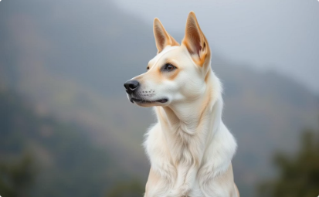

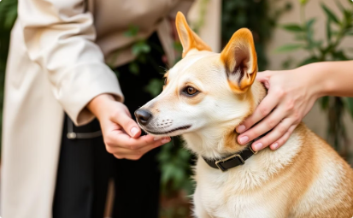


Native Hill Breeds and Adoption
Bhotia Dogs, native to the Himalayan hills.
Families in Uttarakhand, Kashmir, and Himachal with mountain dog companions.
Promoting adoption improves care and visibility of native breeds.
Preserving native species like Bakharwal enhances local identity.
Supporting adoption encourages eco-conscious and inclusive living.

Slide 12
Technology That Drives PawConnect
Location-Based Search
Verified Profiles
Donation Transparency
Notifications
Adoption candidates and pets are thoroughly verified to ensure authentic matches.
Users get alerts for adoption events, vaccinations, and urgent rescue cases.
Users find pets nearby using GPS and filter options for breed, age, and size.
Financial reporting ensures trust and efficient fund allocation.

Slide 13


Join the PawConnect Movement
Adopt a Pet
Give stray animals the loving home they deserve and change lives forever.
Donate
Support shelters and rescue efforts by providing crucial resources.
Volunteer
Contribute to rescue missions, community outreach, and education programs.
Spread Awareness
Help us grow the movement by following, sharing, and engaging on social platforms.
Together, we’re not just saving animals — we’re preserving the soul of the hills.>3!

